Slide 1

Foundation PHYSICS
Seminar 4: SIMPLE MACHINES, FLUIDS AND LIGHT

Slide 2
Learning outcomes
Students will be able to apply critical thinking and analytical skills to solve problems regarding:
Simple Machines
Fluid Dynamics
Reflection and Refraction of Light

Slide 3
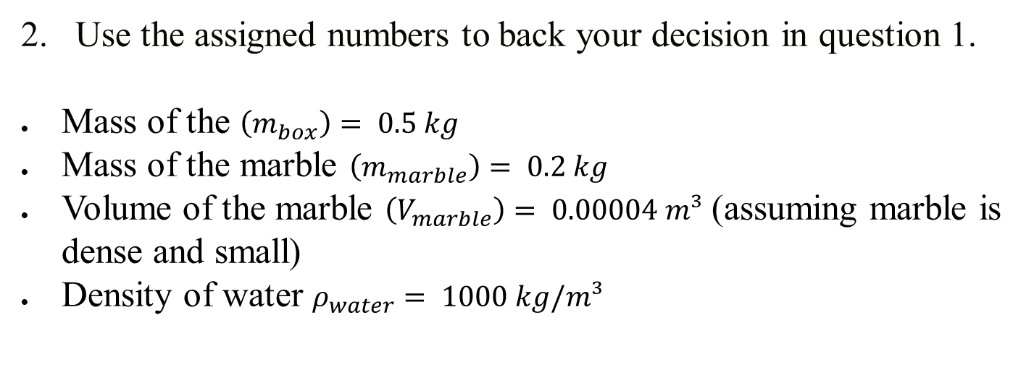
Practices Questions
A marble is in a little box that is floating in a beaker of water. The marble is then removed from the box and dropped into the water, sinking to the bottom. What happens to the water level in the beaker when you do this? Does it go up, go down, or stay the same? Why?
Use the assigned numbers to back your decision in question 1.
Mass of the $\left(m_{box}\right)= 0.5 kg$
Mass of the marble $\left(m_{marble}\right)= 0.2 kg$
Volume of the marble $\left(V_{marble}\right)= 0.00004 m³$ (assuming marble is dense and small)
Density of water $ρ_{water}= 1000 kg/m³$

Slide 4
ANSWER: Practices Question 1
Understanding the Scenario
The box, with the marble inside, displaces a certain amount of water equal to the weight of the box and marble together.
This is due to Archimedes' principle, which states that the buoyant force on an object is equal to the weight of the fluid it displaces.
Analyzing the Water Levels
Before Removing the Marble:
The water level is at a certain height because the floating box with the marble inside displaces a volume of water equal to the weight of the box and the marble combined.

Slide 5
ANSWER: Practices Question 1
After Removing the Marble:
The Box Alone: The box now displaces less water because it weighs less without the marble. This causes the water level to decrease.
The Marble in Water: The marble sinks and displaces water equal to its volume, not its weight.
Comparison of Displacement:
When the Marble was in the Box:
The marble contributed to the total weight of the box, causing the box to displace a volume of water equal to the combined weight.

Slide 6
ANSWER: Practices Question 1
When the Marble is in the Water:
The marble now displaces a volume of water equal to its own volume, which is less than the volume displaced by the box when it had the marble inside (because the marble is denser than water).
Conclusion:
The water level in the beaker goes down when the marble is removed from the box and dropped into the water.
This is because the box alone displaces less water (due to its decreased weight), and the marble displaces less water when it sinks (because it displaces water by its volume, not its weight).

Slide 7
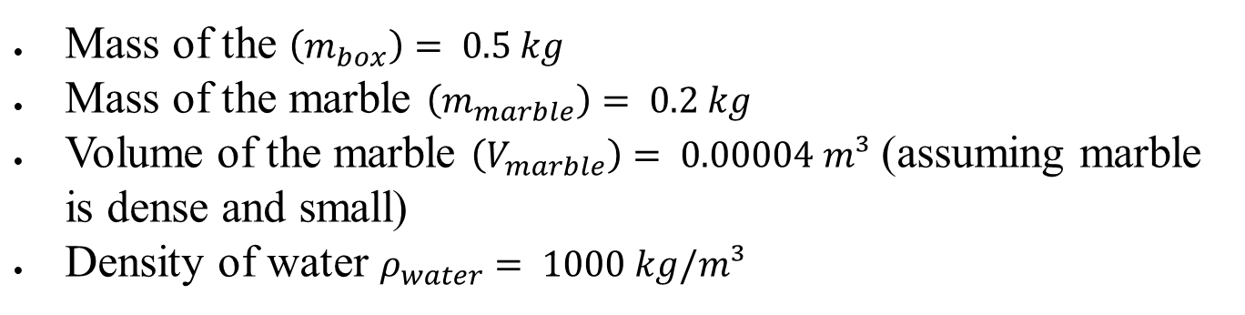

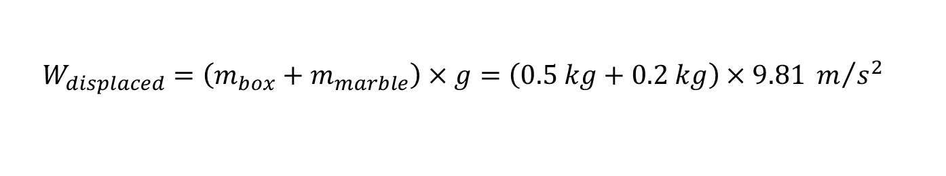
ANSWER: Practices Question 2
Assigned numbers:
Mass of the $\left(m_{box}\right)= 0.5 kg$
Mass of the marble $\left(m_{marble}\right)= 0.2 kg$
Volume of the marble $\left(V_{marble}\right)= 0.00004 m³$ (assuming marble is dense and small)
Density of water $ρ_{water}= 1000 kg/m³$
Initial Displacement (Box + Marble Floating)
According to Archimedes' principle, the weight of the water displaced equals the total weight of the box and marble:
Weight of displaced water $=(Mass of box+Mass of marble)×g$
$$W_{displaced}=\left(m_{box}+m_{marble}\right)×g=\left(0.5 kg+0.2 kg\right)×9.81 m/{s^{2}}$$
$$W_{displaced}=6.867 N$$

Slide 8
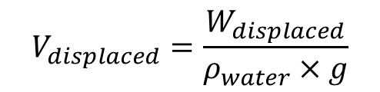

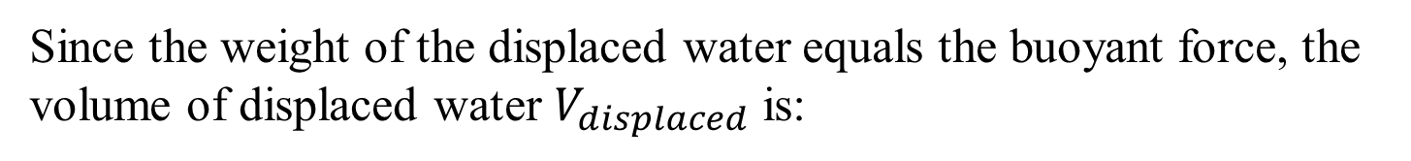

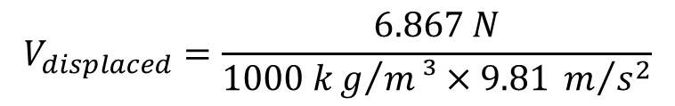
ANSWER: Practices Question 2
Since the weight of the displaced water equals the buoyant force, the volume of displaced water $V_{displaced}$​ is:
$$V_{displaced}=\frac{W_{displaced}}{ρ_{water}×g}$$
$$V_{displaced}=\frac{6.867 N}{1000 kg/m³×9.81 m/{s^{2}}}$$
$$V_{displaced}=0.0007 m^{3}$$
After Removing the Marble
The Box Alone:
Now, the box alone displaces less water. The volume displaced by the box is:
$$V_{box displaced}=\frac{m_{box}×g}{ρ_{water}×g}=\frac{0.5 kg×9.81 m/{s^{2}}}{1000 kg/m³×9.81 m/{s^{2}}}$$
$$V_{box displaced}=0.0005 m^{3}$$

Slide 9


ANSWER: Practices Question 2
The Marble in the Water:
When the marble sinks, it displaces an amount of water equal to its volume:
$$V_{marble displaced}= 0.00004 m³$$
Total Displacement After Removing the Marble
Now, we sum the displacement of the box and the marble:
$$V_{total after}=V_{box displaced}+V_{marble displaced}$$
$$V_{total after}=0.0005 m^{3}+0.00004 m^{3}=0.00054{ m}^{3}$$
$$V_{total after}=0.00054{ m}^{3}$$
Comparing Water Levels
Initial Volume Displaced: $V_{displaced}=0.0007 m^{3}$
Final Volume Displaced: $V_{total after}=0.00054{ m}^{3}$
The final volume of displaced water is less than the initial volume, meaning the water level goes down.

Slide 10
Question 1
A seesaw (lever) is 4 meters long and has a pivot point in the center. A child of mass 30 kg sits 1.5 meters from the pivot on one side, and another child of mass 20 kg sits on the opposite side 2m from the pivot.
Calculate the moment of force exerted by each child.
Determine the position where a third child of mass 25 kg should sit on the seesaw to balance it.
If the third child sits 1 meter away from the pivot on the same side as the first child, calculate the net moment and determine if the seesaw is balanced or not.

Slide 11
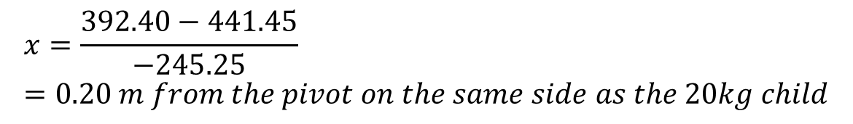



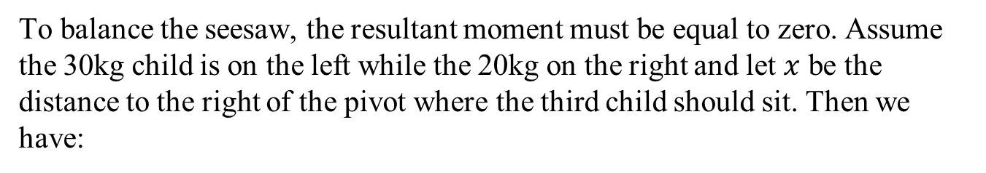

Question 1: ANSWERS
(a) Moment of force
$$M_{f}=F×d_{⊥}$$
Where $d_{⊥}$is the perpendicular distance
Moment of force for the first child:
$$M_{1}=30×9.81×1.5=441.45 Nm$$
Moment of force for the second child:
$$M_{2}=20×9.81×2=392.40 Nm (in the opposite direction)$$
(b) To balance the seesaw
To balance the seesaw, the resultant moment must be equal to zero. Assume the 30kg child is on the left while the 20kg on the right and let $x$ be the distance to the right of the pivot where the third child should sit. Then we have:
$$30×9.81×1.5=25×9.81×x+20×9.81×2$$
Solving for $x$, we get:
$$x=\frac{392.40−441.45}{−245.25}=0.20 m from the pivot on the same side as the 20kg child$$

Slide 12

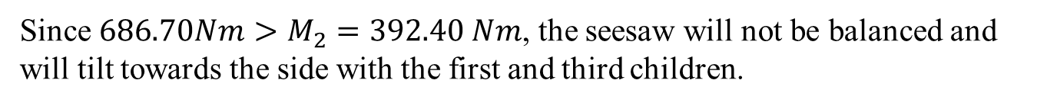
Question 1: ANSWERS
(c) Net moment if the third child sits 1 meter from the pivot
$$M_{3}=25×9.81×1=245.25 Nm$$
Net moment on the side with the first and third children:
$$M_{1+3}=441.45+245.25=686.70 Nm$$
Since $686.70Nm>M_{2}=392.40 Nm$, the seesaw will not be balanced and will tilt towards the side with the first and third children.

Slide 13
Question 2
A cylindrical object with a height of 2 meters and a base area of 0.5 m² is floating in water. The density of the object is 600 kg/m³, and the density of water is 1000 kg/m³.
Draw a diagram of the object floating in water, indicating the forces acting on it (gravitational force and buoyant force).
Calculate the volume of the object submerged in water.
Determine the buoyant force acting on the object.
If a 100 kg weight is placed on top of the object, calculate the new volume submerged.

Slide 14
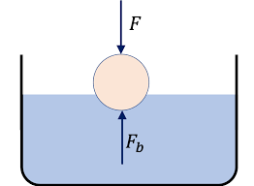
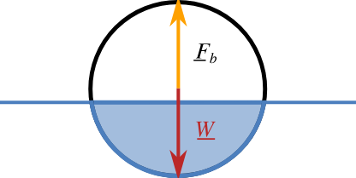


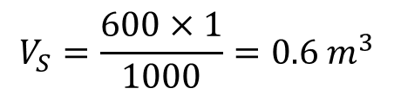

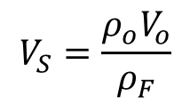




Question 2: ANSWERS
(a) Diagram of the object floating in water
(b) Volume of the object submerged in water
If the cylindrical object is floating it means is stationary is not going down or up.
This implies that the net force in the y-direction make be zero.
$$F_{b}−W=0→F_{b}=W$$
$$F_{b}=ρ_{F}×V_{S}×g$$
$$W=m_{o}g$$
$$ρ_{F}×V_{S}×g=m_{o}g$$
$$m_{o}=ρ_{o}V_{o}$$
$$ρ_{F}×V_{S}×g=ρ_{o}V_{o}g$$
$$ρ_{F}×V_{S}=ρ_{o}V_{o}$$
$$V_{S}=\frac{ρ_{o}V_{o}}{ρ_{F}}$$
$$V_{S}=\frac{600×1}{1000}=0.6 m^{3}$$

Slide 15






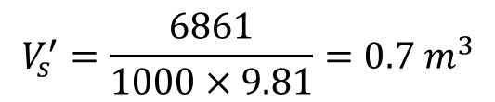
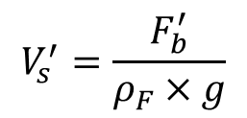
Question 2: ANSWERS
(c) Buoyant force acting on the object
$$F_{b}=ρ_{F}×V_{S}×g$$
$$F_{b}=1000×0.6×9.81=5880 N$$
(d) New submerged volume $V_{s}^{′}$
$$W=mg$$
$$W=100×9.81=981 N$$
Total force:
$$F_{b}^{′}=5880+981=6861 N$$
Submerged volume:
$$F_{b}^{′}=ρ_{F}×V_{s}^{′}×g$$
$$V_{s}^{′}=\frac{F_{b}^{′}}{ρ_{F}×g}$$
$$V_{s}^{′}=\frac{6861}{1000×9.81}=0.7 m^{3}$$

Slide 16
Question 3
A wheelbarrow is used to lift a load of 2000 N with the effort applied at the handles being 500 N. The distance from the wheel (pivot) to the center of the load is 0.5 m, and the distance from the wheel to the handles is 1.5 m.
Calculate the mechanical advantage of the wheelbarrow.
Determine the efficiency of the wheelbarrow if the actual effort required is 600 N.
If the load is increased to 2500 N, what effort is needed to lift it (assume 100% efficiency )?

Slide 17
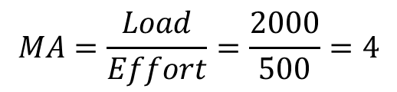
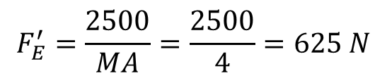
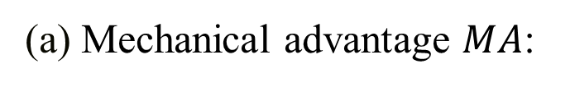
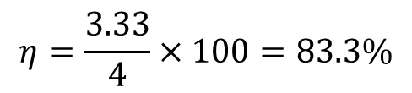
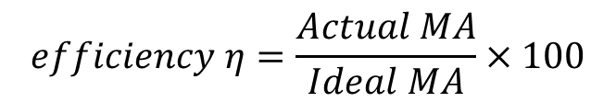
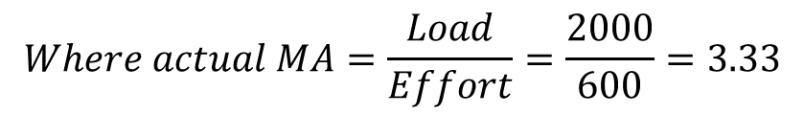
Question 3: ANSWERS
(a) Mechanical advantage $MA$:
$$MA=\frac{Load}{Effort}=\frac{2000}{500}=4$$
(b) Efficiency:
$$Where actual MA=\frac{Load}{Effort}=\frac{2000}{600}=3.33$$
$$efficiency η=\frac{Actual MA}{Ideal MA}×100$$
$$η=\frac{3.33}{4}×100=83.3\%$$
(c) New effort for load 2500 N:
$$F_{E}^{′}=\frac{2500}{MA}=\frac{2500}{4}=625 N$$

Slide 18
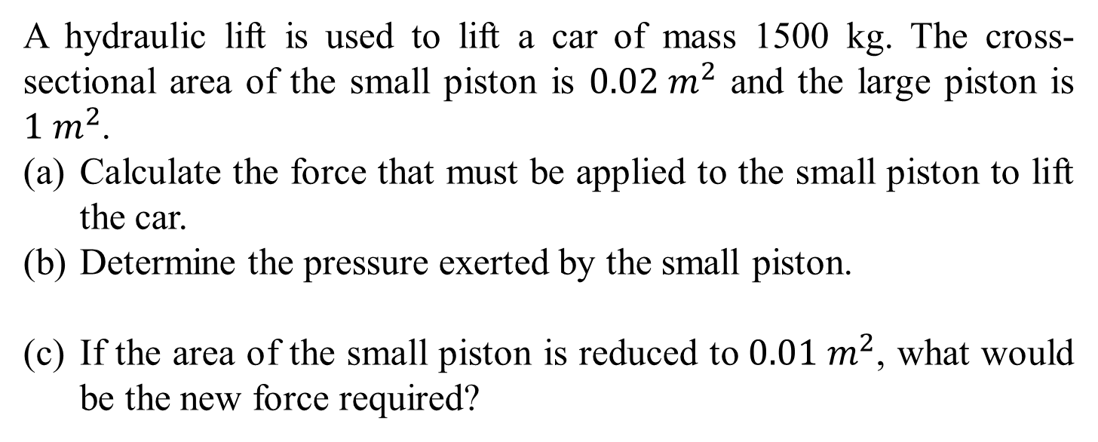
Question 4
A hydraulic lift is used to lift a car of mass 1500 kg. The cross-sectional area of the small piston is $0.02 m^{2}$ and the large piston is $1 m^{2}$.
Calculate the force that must be applied to the small piston to lift the car.
Determine the pressure exerted by the small piston.
If the area of the small piston is reduced to$0.01 m^{2}$, what would be the new force required?

Slide 19
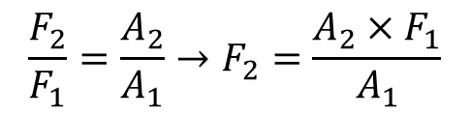
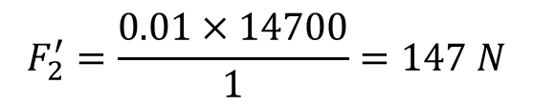

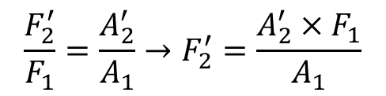
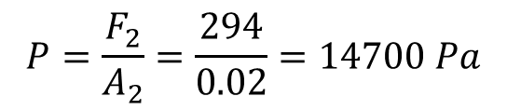
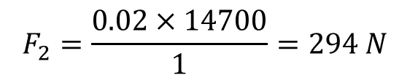
Question 4: ANSWERS
(a) Force required on the small piston
$$F_{1}=mg=1500×9.81=14700 N$$
$$\frac{F_{2}}{F_{1}}=\frac{A_{2}}{A_{1}}→F_{2}=\frac{A_{2}×F_{1}}{A_{1}}$$
$$F_{2}=\frac{0.02×14700}{1}=294 N$$
(b) Pressure exerted by the small piston
$$P=\frac{F_{2}}{A_{2}}=\frac{294}{0.02}=14700 Pa$$
(c) Pressure exerted by the small piston with the new reduced cross sectional area.
$$\frac{F_{2}^{′}}{F_{1}}=\frac{A_{2}^{′}}{A_{1}}→F_{2}^{′}=\frac{A_{2}^{′}×F_{1}}{A_{1}}$$
$$F_{2}^{′}=\frac{0.01×14700}{1}=147 N$$

Slide 20
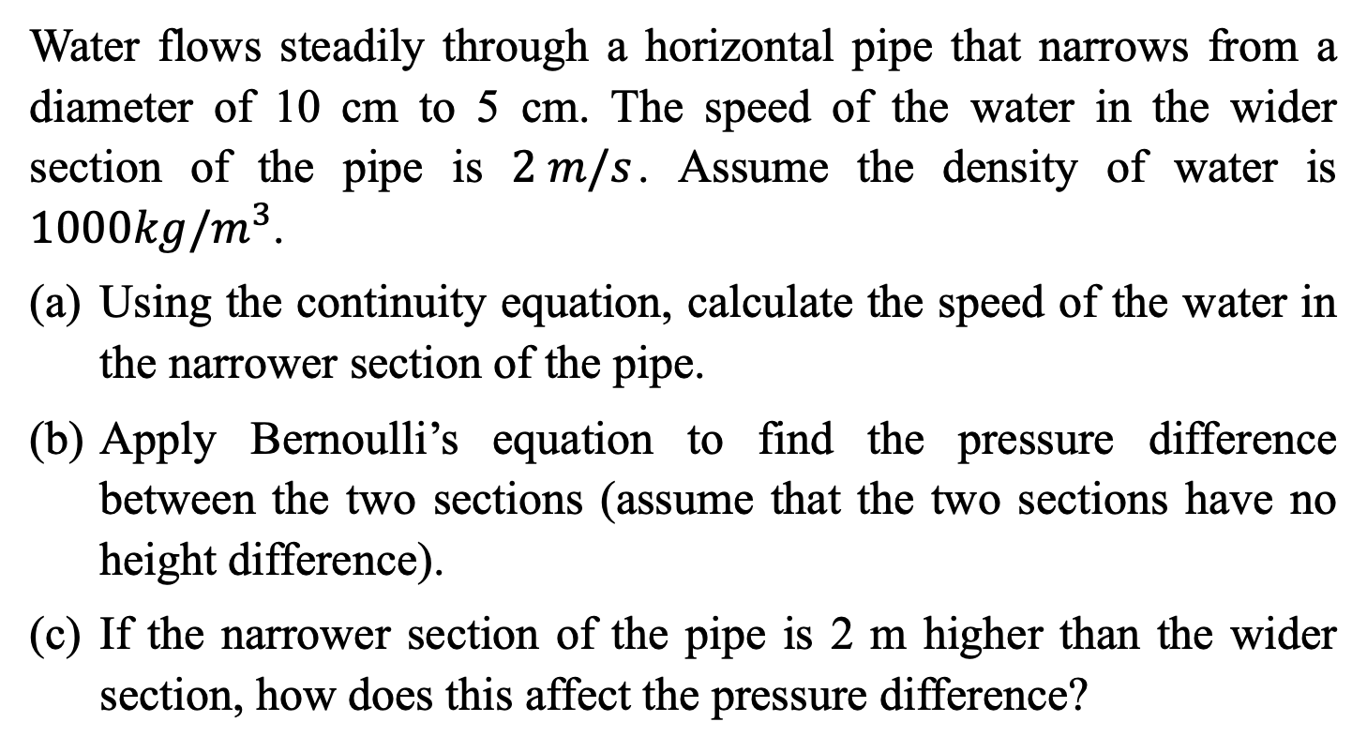
Question 5
Water flows steadily through a horizontal pipe that narrows from a diameter of 10 cm to 5 cm. The speed of the water in the wider section of the pipe is $2 m/s$. Assume the density of water is $1000kg/m^{3}$.
Using the continuity equation, calculate the speed of the water in the narrower section of the pipe.
Apply Bernoulli’s equation to find the pressure difference between the two sections (assume that the two sections have no height difference).
If the narrower section of the pipe is 2 m higher than the wider section, how does this affect the pressure difference?

Slide 21
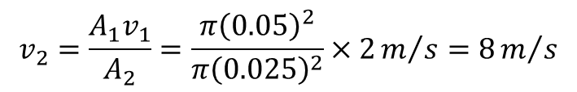
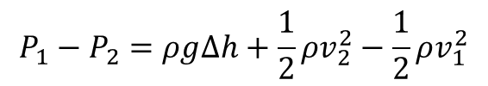

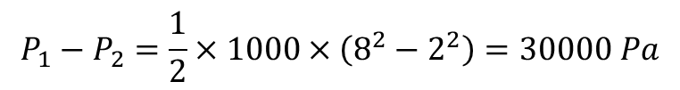
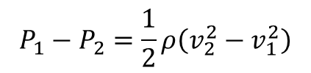
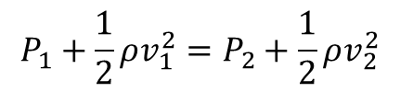
Question 5: ANSWERS
(a) Using the continuity equation
$A_{1}v_{1}=A_{2}v_{2}$​
$$v_{2}=\frac{A_{1}v_{1}}{A_{2}}=\frac{π{\left(0.05\right)}^{2}}{π{\left(0.025\right)}^{2}}×2m/s=8m/s$$
(b) Using Bernoulli’s equation
$$P_{1}+\frac{1}{2}ρv_{1}^{2}=P_{2}+\frac{1}{2}ρv_{2}^{2}$$
$$P_{1}−P_{2}=\frac{1}{2}ρ\left(v_{2}^{2}−v_{1}^{2}\right)$$
$$P_{1}−P_{2}=\frac{1}{2}×1000×\left(8^{2}−2^{2}\right)=30000 Pa$$
(c) With a height difference
$$P_{1}−P_{2}=ρg∆h+\frac{1}{2}ρv_{2}^{2}−\frac{1}{2}ρv_{1}^{2}$$
$$P_{1}−P_{2}=1000×9.81×2+30000=49620 Pa$$
The pressure difference increases due to the height difference.

Slide 22
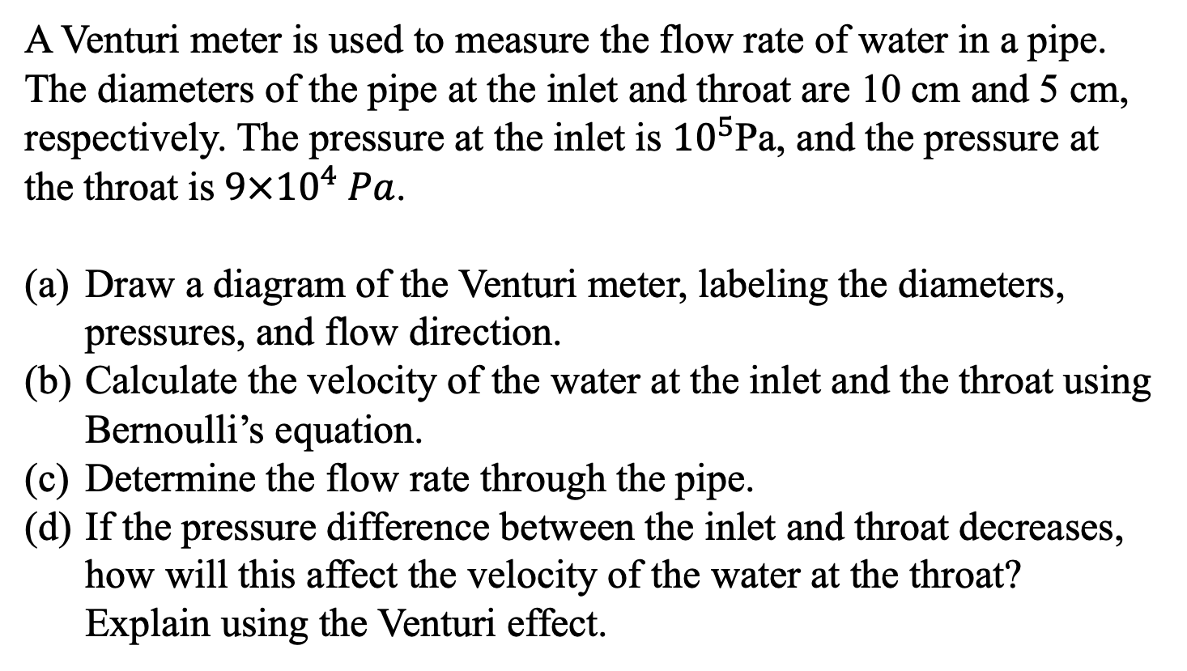
Question 6
A Venturi meter is used to measure the flow rate of water in a pipe. The diameters of the pipe at the inlet and throat are 10 cm and 5 cm, respectively. The pressure at the inlet is ${10}^{5}$Pa, and the pressure at the throat is$9×{10}^{4} Pa$.
Draw a diagram of the Venturi meter, labeling the diameters, pressures, and flow direction.
Calculate the velocity of the water at the inlet and the throat using Bernoulli’s equation.
Determine the flow rate through the pipe.
If the pressure difference between the inlet and throat decreases, how will this affect the velocity of the water at the throat? Explain using the Venturi effect.

Slide 23
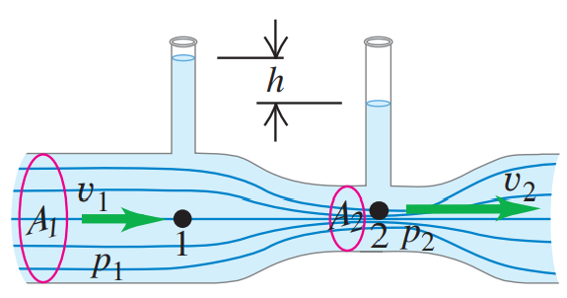
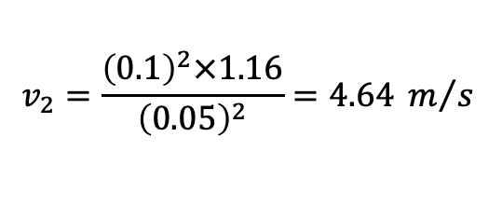
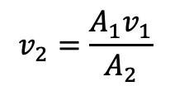
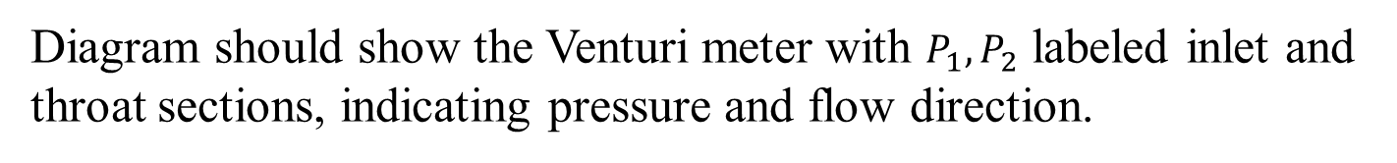
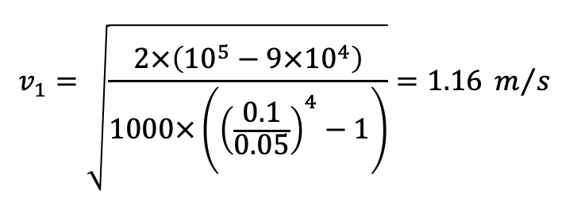
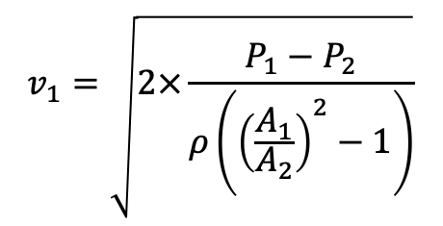
Question 6: ANSWERS
(a) Diagram of the Venturi meter
Diagram should show the Venturi meter with $P_{1},P_{2}$ labeled inlet and throat sections, indicating pressure and flow direction.
(b) Using Bernoulli’s equation$: P_{1}+\frac{1}{2}ρv_{1}^{2}=P_{2}+\frac{1}{2}ρv_{2}^{2} and using:A_{2}v_{2}=A_{1}v_{1}$
$$v_{1}=\sqrt{2×\frac{P_{1}−P_{2}}{ρ\left({\left(\frac{A_{1}}{A_{2}}\right)}^{2}−1\right)}}$$
$$v_{1}=\sqrt{\frac{2×\left({10}^{5}−9×{10}^{4}\right)}{1000×\left({\left(\frac{0.1}{0.05}\right)}^{4}−1\right)}}=1.16 m/s$$
$$v_{2}=\frac{A_{1}v_{1}}{A_{2}}$$
$$v_{2}=\frac{{\left(0.1\right)}^{2}×1.16}{{\left(0.05\right)}^{2}}=4.64 m/s$$

Slide 24

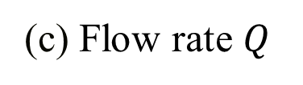
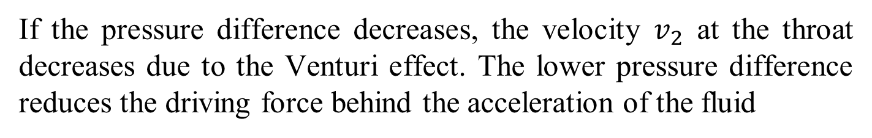
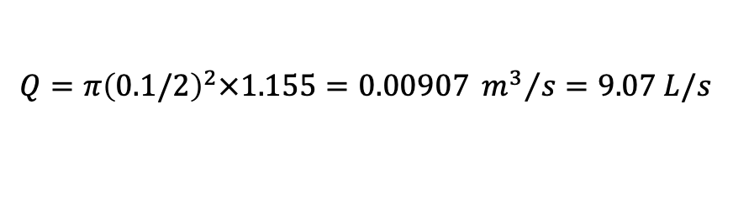
Question 6: ANSWERS
(c) Flow rate $Q$
$$Q=A_{1}v_{1}$$
$$Q=π{\left(0.1/2\right)}^{2}×1.155=0.00907 {m^{3}}/{s=9.07 L/s}$$
(d) Pressure difference
If the pressure difference decreases, the velocity $v_{2}$​ at the throat decreases due to the Venturi effect. The lower pressure difference reduces the driving force behind the acceleration of the fluid

Slide 25
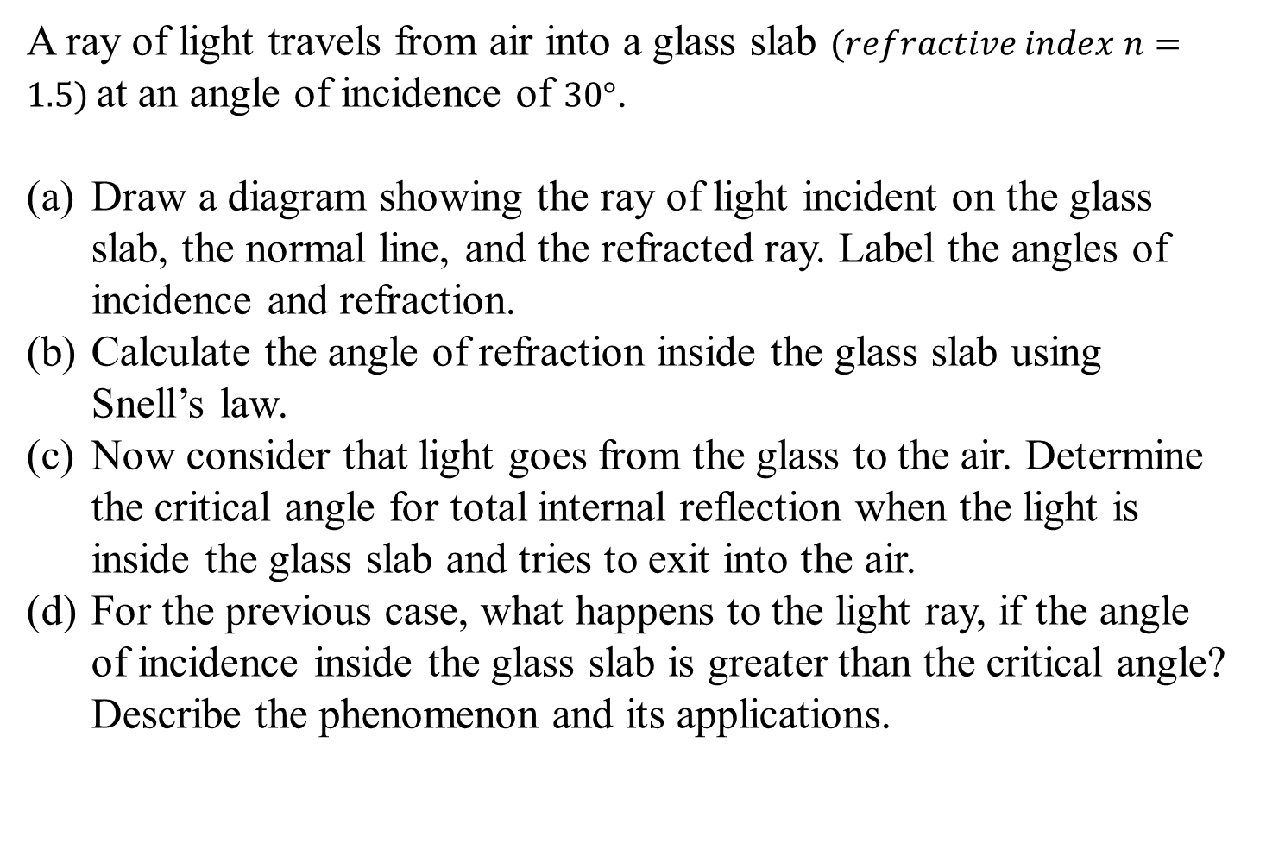
Question 7
A ray of light travels from air into a glass slab $(refractive index n=1.5)$at an angle of incidence of $30°$.
Draw a diagram showing the ray of light incident on the glass slab, the normal line, and the refracted ray. Label the angles of incidence and refraction.
Calculate the angle of refraction inside the glass slab using Snell’s law.
Now consider that light goes from the glass to the air. Determine the critical angle for total internal reflection when the light is inside the glass slab and tries to exit into the air.
For the previous case, what happens to the light ray, if the angle of incidence inside the glass slab is greater than the critical angle? Describe the phenomenon and its applications.

Slide 26
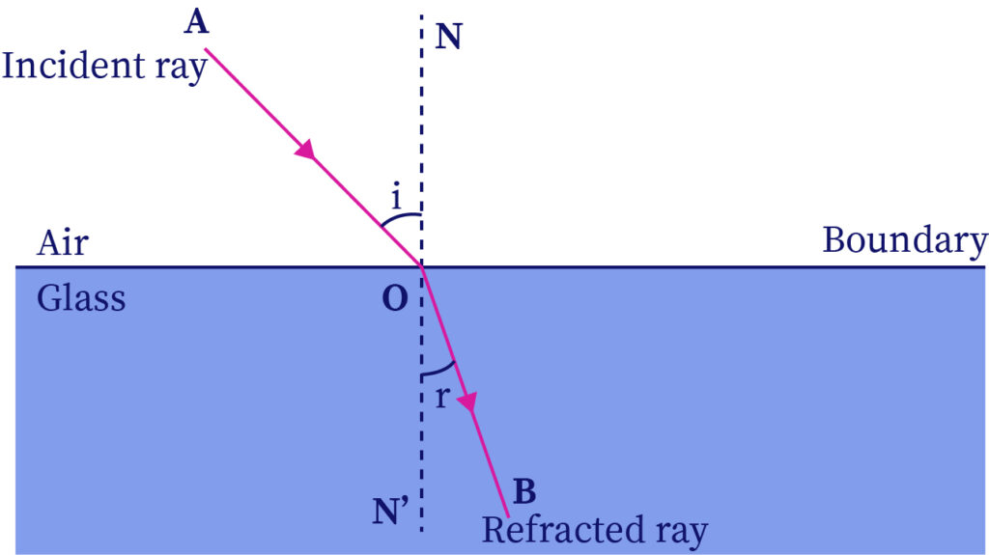


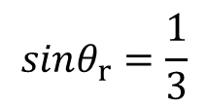
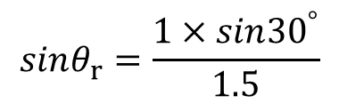

Question 7: ANSWERS
(a) Diagram showing the ray of light incident on the glass slab
(b) Angle of refraction
$$n_{1}sinθ_{i}=n_{2}sinθ_{r}$$
$$1×sin{30}^{°}=1.5×sinθ_{r}$$
$$sinθ_{r}=\frac{1×sin{30}^{°}}{1.5}$$
$$sinθ_{r}=\frac{1}{3}$$
$$θ_{r}={19.5}^{°}$$

Slide 27
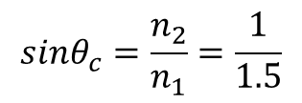
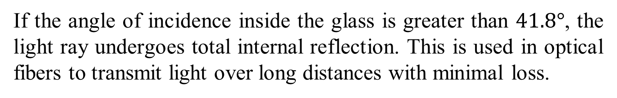

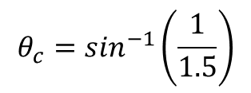
Question 7: ANSWERS
(c) Critical angle $θ_{c}$
$$sinθ_{c}=\frac{n_{2}}{n_{1}}=\frac{1}{1.5}$$
$$θ_{c}=\sin^{−1}\left(\frac{1}{1.5}\right)$$
$$θ_{c}=41.8°$$
(d) Describe the phenomenon and its applications
If the angle of incidence inside the glass is greater than $41.8°$, the light ray undergoes total internal reflection. This is used in optical fibers to transmit light over long distances with minimal loss.

Slide 28



Question 8
Lift on an airplane. Air flows horizontally past a small airplane’s wings such that the speed is 70 m/s over the top surface and 60 m/s under the bottom surface. If the plane has a mass of 1340 kg and a wing area of 16.2 m², what is the net vertical force (including the effects of gravity) on the airplane? The density of the air is 1.20 $kg/m^{3}$.

Slide 29



Question 8: ANSWERS
Calculate the Lift Force
The lift force $\left(F_{lift}\right)$can be calculated using Bernoulli's principle, which relates the pressure difference across the wing to the difference in speed of the airflow.
Bernoulli's equation gives us:
Here:
$P_{1}$​ is the pressure on the bottom of the wing.
$P_{2}$​ is the pressure on the top of the wing.
$ρ$ is the density of the air (1.20 kg/m³).
$v_{1}$​ is the speed of the air under the wing (60 m/s).
$v_{2}$​ is the speed of the air over the wing (70 m/s).

Slide 30









Question 8: ANSWERS
Calculate the Lift Force
We are treating air as incompressible fluid – this is an approximation. The pressure difference $\left(∆P\right)$between the bottom and the top of the wing is (ignoring the thickness of the wing):
$$\left(∆P\right)=P_{1}−P_{2}=\frac{1}{2}ρ\left(v_{2}^{2}−v_{1}^{2}\right)$$
Substituting the values:
$$\left(∆P\right)=P_{1}−P_{2}=\frac{1}{2}\left(1.20\right)×\left({70}^{2}−{60}^{2}\right)$$
$$\left(∆P\right)=\frac{1}{2}\left(1.20\right)×\left({70}^{2}−{60}^{2}\right)$$
$$\left(∆P\right)=0.60×\left(4900−3600\right)N/{m^{2}}$$
$$\left(∆P\right)=0.60×1300 N/{m^{2}}$$
$$\left(∆P\right)=780 N/{m^{2}}$$
The lift force is the pressure difference times the wing area $(A=16.2 m^{2}):$
$$F_{lift}=2×∆P×A=2×780 N/{m^{2}}×16.2 m^{2}$$
$$F_{lift}=25272 N$$

Slide 31








Question 8: ANSWERS
Calculate the Weight of the Airplane
The weight $(W)$ of the airplane is given by:
$$W=mg$$
Where:
$m=1340 kg$ is the mass of the airplane.
$g=9.81 m/s^{2}$ is the acceleration due to gravity.
$$W=1340 kg×9.81m/{s^{2}}=13145.4N$$
Calculate the Net Vertical Force
The net vertical force $\left(F_{net}\right)$ on the airplane is the difference between the lift force and the weight:
$$F_{net}=F_{lift}−W$$
$$F_{net}=25272 N−13145.4 N$$
$$F_{net}=+12126.6 N$$

Slide 32
Question 8: ANSWERS
Calculate the Net Vertical Force
The net vertical force on the airplane is +12126.6 N. The airplane is experiencing an upward net force, indicating that the lift from its two wings is sufficient to completely counteract its weight.

Slide 33
Q&A? Office hours:

Slide 34
Question 9-Extension
A cube of side length 10.0 cm and made of unknown material floats at the surface between water and oil. The oil has a density of 810 kg/m³. If the cube floats so that it is 72% in the water and 28% in the oil (hence it is completely submerged), what is the mass of the cube and what is the buoyant force on the cube?

Slide 35




Question 9: ANSWERS
The weight of the object must be balanced by the two buoyant forces, one from the water and one from the oil. The buoyant force is the density of the liquid, times the volume in the liquid, times the acceleration due to gravity. We represent the edge length of the cube by$l$.
$$mg=F_{oil}+F_{water}=ρ_{oil}V_{oil}g+ρ_{water}V_{water}g$$
$$mg=ρ_{oil}l^{2}\left(0.28l\right)g+ρ_{water}l^{2}\left(0.72l\right)g$$
$$m=l^{3}\left(ρ_{oil}\left(0.28\right)+ρ_{water}\left(0.72\right)\right)$$
$$m={\left(0.1\right)}^{3}\left[0.28\left(810{kg}/{m^{2}}\right)+0.72\left(1000{kg}/{m^{2}}\right)\right]$$
$$m=0.95 kg$$
The buoyant force is the weight of the object,
$$F_{buoy}=0.95 kg×9.81m/{s^{2}}=9.32 N$$

Slide 36

Question 10-Extension
A person whose eyes are 1.64 m above the floor stands 2.30 m in front of a vertical plane mirror whose bottom edge is 38 cm above the floor, as shown in the figure below. What is the horizontal distance x to the base of the wall supporting the mirror of the nearest point on the floor that can be seen reflected in the mirror?

Slide 37




Question 10: ANSWERS
The angle of incidence is the angle of reflection. See the diagram for the appropriate lengths.
$$tanθ=\frac{\left(H−h\right)}{I}=\frac{h}{x}$$
$$\frac{h}{x}=\frac{\left(1.64m −0.38m\right)}{2.30m}=\frac{\left(0.38m\right)}{x}$$
$$x=0.69 m$$

Slide 38
Question 11-Extension
A fish tank has dimensions 36 cm wide by 1.0 m long by 0.60 m high. If the filter should process all the water in the tank once every 4.0 h, what should the flow speed be in the 3.0 cm diameter input tube for the filter?

Slide 39


Question 11: ANSWERS
The flow speed is the speed of the water in the input tube. The entire volume of the water in the tank is to be processed in 4.0 h. The volume of water passing through the input tube per unit time is the volume rate of flow, as expressed below:
$$\frac{V}{∆t}=Av →v=\frac{V}{A∆t}=\frac{lwh}{πr^{2}∆t}$$
$$v=\frac{\left(0.36m\right)\left(1.0m\right)\left(0.60m\right)}{π{\left(0.015m\right)}^{2}\left(4.0h\right)\left(\frac{3600s}{1h}\right)}=0.02122m/s$$

